Slide 1
NON-TRADITIONAL RESIDENTIAL LENDING PLATFORM
Clark Knoblock | Account Executive

Slide 2
AGENDA
Introductions
Opportunities and Programs
Training and Contacts
Q&A

Slide 3
DO GOOD BY DOING GOOD
By partnering with Change Wholesale, originators will be able to grow their business exponentially by expanding their ability to serve borrowers who qualify for prime mortgages without income, employment or DTI documentation.
Servicing Underserved Borrowers Since 1994

Slide 4
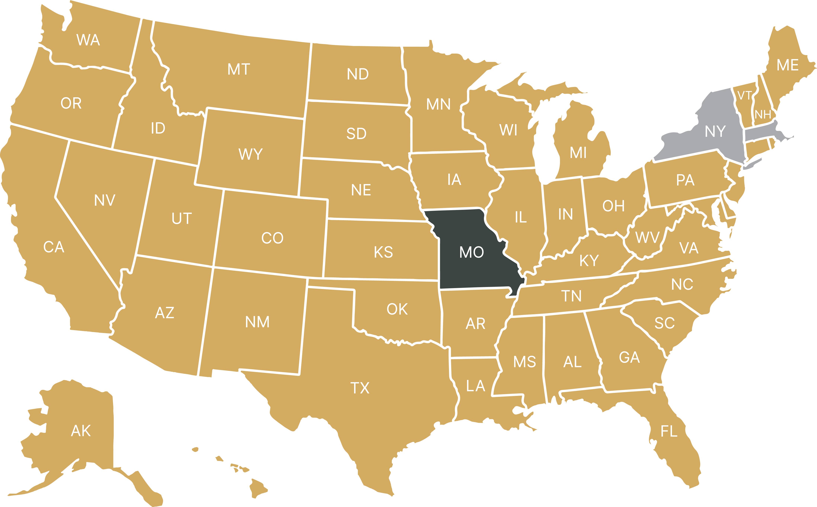
AMERICA'S CDFI
Certified as a CDFI by the U.S. Department of the Treasury
Founded in 1994
Licensed in 47 states & District of Columbia
Investment grade "A" credit rating by National Credit Rating Agency Egan Jones
Approved Seller/Servicer with FNMA, FHLMC and GNMA
Approved by the FHA, VA and USDA
Portfolio Mortgage Programs including Community Mortgage, Alternate Documentation, Jumbo, Investor, Foreign National and Bridge Loan

Slide 5
Full suite of Non-Agency products including:
Investor DSCR and Ration 75%>100%
12-months Bank Statements
1-yr Income Documentation
1099-only and W2 Only
Asset Depletion
Flagship Product Solution: Community Mortgage
Income and Employment Verification not required
Owner-Occupied and 2nd Homes
PRODUCTS & OPPORTUNITES

Slide 6
COMMUNITY HIGHLIGHTS AND NICHES
*80% LTV 740+ FICO ON OWNER OCCUPIED 1-4 UNITS & 2ND HOMES (NO REDUCTION IN LTV FOR MULTIFAMILY)
*75% LTV FOR FICOS 680-739
*70% LTV FOR CASHOUT TRANSACTIONS
*RESERVES MUST BE BORROWERS, DOWN PAYMENT AND CLOSING COSTS CAN BE GIFTED
*ASSETS SOURCED & SEASONED FOR ONLY 30 DAYS - Large deposit is considered anything over 10% of the loan amount
*NO EMPLOYMENT OR INCOME ON 1003
*1 TRADELINE FOR 24 MONTHS OR 2 TRADELINES FOR 12 MONTHS OPEN AND ACTIVE WITHIN THE LAST 90 DAYS
*BK ONE DAY OUT – F/C, SHORT SALE OR DEED IN LIEU 12 MONTHS SEASONING
*CASH-OUT CAN BE USED AS RESERVES FOR CASH-OUT TRANSACTIONS – NO LIMIT ON CASH-OUT
*UP TO $3 MILLION LOAN AMOUNTS
RATES STARTING AT 7.75% (the One!)
WHO IS THIS IDEAL FOR?
Self-Employed/Small Business Owner
Volatile or Irregular Income
Retired
Seasonal & Gig Workers
Real Estate Investors
Owners & Employees of Cash Businesses
Newly Self-Employed
Disqualified Income
Getting out of a Hard Money loan

Slide 7
COMMUNITY MORTGAGE
Effective date 03/01/2023
Primary Residence & Second Home
 | LTV / CLTV | FICO | Reserves
Purchase / Rate & Term Refinance | 80% / 80% | 740 | 12 months
 | 75% / 75% | 680 | 15 months
 | 70% / 70% | 660 | 18 months
 | 65% / 65% | 640 | 24 months
Primary Residence & Second Home
 | LTV / CLTV | FICO | Reserves
Cash Out Refinance | 70% / 70% | 740 | 12 months
 |  | 700 | 15 months
 |  | 660 | 18 months
Maximum Loan Amounts
> $1,000,000 up to $2,000,000 max |  | 80% LTV / 80% CLTV
> $2,000,000 up to $3,000,000 max
Interest Only
All Interest Only transactions are capped at 75% max LTV/CLTV
Additional Financed Properties
Refer to guidelines for reserve requirement calculations tied to additional financed properties owned by borrower(s).
Products
1/6 ARM, 5/6m ARM, 7/6m ARM, 10/6 ARM |  | 30 Yr Fixed
5/6 ARM IO, 7/6 ARM IO, 10/6 ARM IO |  | 30 Yr Fixed IO
Interest Only (IO) Period | Amortization Term | Maturity
10 Years | 20 Years | 30 Years
ARM Margins & Caps
1/6 Month ARM* | Margin: 5.00 | Caps 2/2/5
5/6 Month ARM | Margin: 4.50 | Caps 2/2/5
7/6 Month ARM | Margin: 4.50 | Caps 5/2/5
10/6 Month ARM | Margin: 4.50 | Caps 5/2/5
Index= 30 Day Avg SOFR Floor= Margin.
*1/6 Month ARM additional product details: **Floor= Margin. Max loan amount= $2,500,000. Interest Only not permitted. Refer to guidelines for State restrictions.
Credit Requirements
Mortgage History Foreclosure Seasoning Short Sale/DIL Seasoning BK Seasoning | 0 x 30 x 12 12 months 12 months Settled/Discharged
Click Here for Additional Program Requirements
7
7

Slide 8
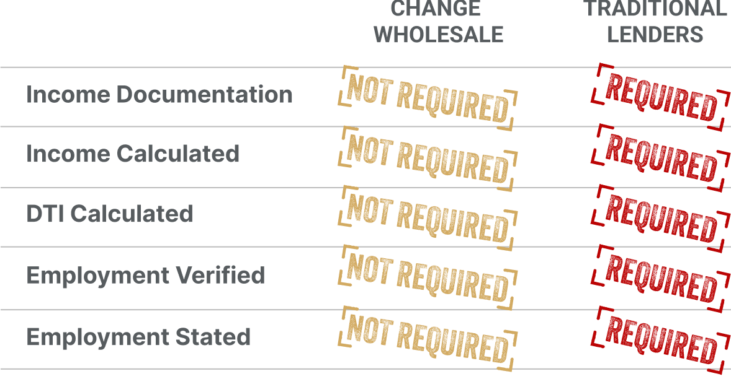
The Community Mortgage program fills the void and addresses the regulatory rules limiting prime borrowers’ access to lending by eliminating unnecessary documents that are not part of the credit underwriting decision.
THE COMMUNITY MORTGAGE*
The industry’s most innovative product
*The Community Mortgage loan program is not available in DC, MD ME, NV, PA, WA, or WV. CA: Interest-only may be prohibited based on FICO score restrictions. CO: All loan transactions require fully executed CO LO Reasonable Inquiry Attestation and HUD Counseling Certification from the Colorado Housing Assistance Corporation. IL: Allowed provided payment is based on fully indexed rate. TX: Interest-only prohibited. TX 50(a)(6) not permitted. OH: Interest-only prohibited on Adjustable-Rate (ARM) loans.

Slide 9
THE ONE SIX ARM
Lower rates today. Fair rates tomorrow.
LLPA Type | Price Adjustment
FICO 700-739 | -0.500
FICO < 700 | -1.000
LTV > 65% | -0.500
Loan Balance $1.5M - $2.5M* | -0.500
Cash-Out Refinance | -0.500
2-4 Unit Property and Condo | -0.500
1/6 SOFR ARM
ALT-DOC
COMMUNITY
Rate: 6.99%
30-Day Price: 100.00
Rate: 7.75%
30-Day Price: 100.00
**CDFI eligible files receive a credit for the $1,795 underwriting fee**
*$2.5M max loan balance.

Slide 10
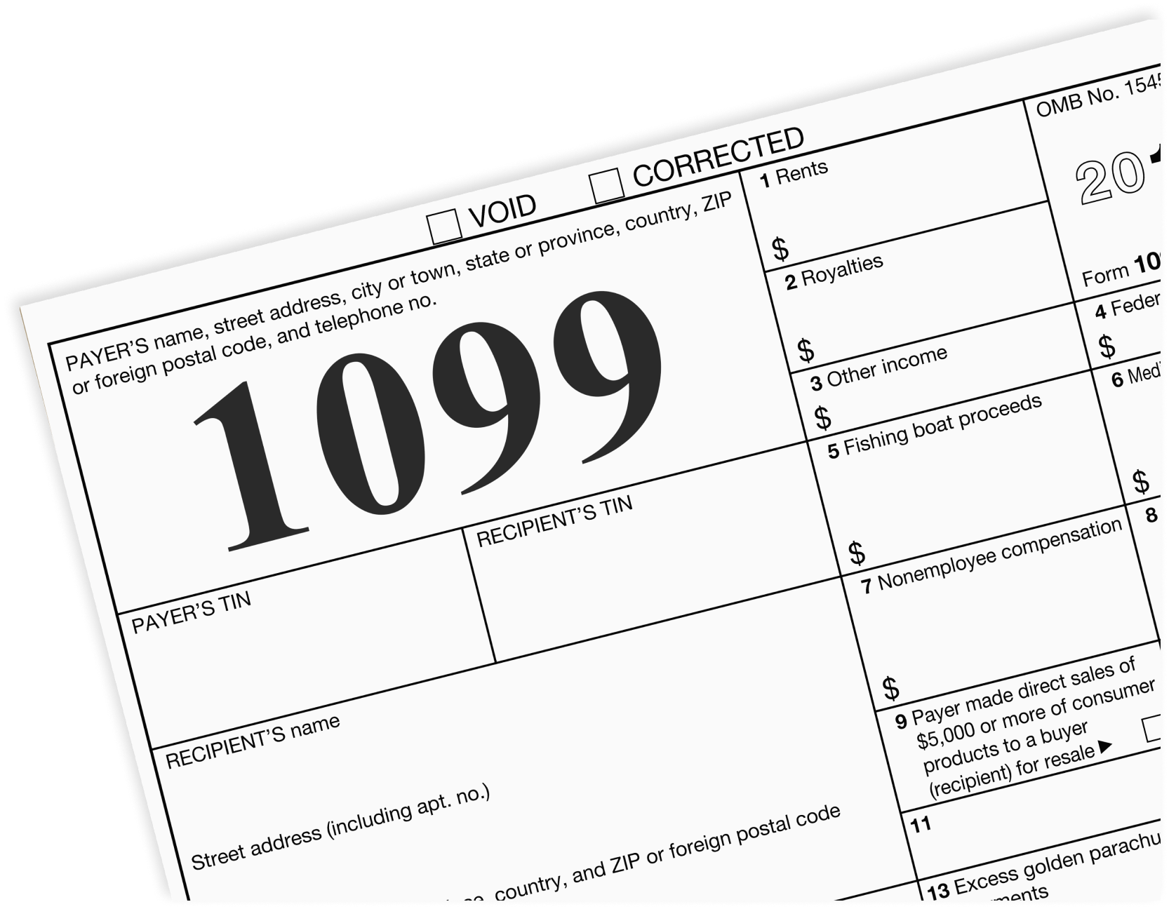
ALT DOC PRICING : Pricing at or near the top of LoanSifter
12 MONTH BANK STATEMENT
1 YEAR TAX RETURN
W2 ONLY
1099 ONLY
ASSET QUALIFIER
Highlights of ALT DOC:
Loan Amounts to $4 million
LTV/CLTV 80%
DTI Up to 50% Allowed
Interest Only Available and can qualify off Interest Only Payment
Bank Statement- Can use just first page of Bank Statement if there isn’t a 20% Variance!
Personal Bank Statements- 100% of deposits
Max cash in hand $2M on cash-out- Texas not allowed
Only need to prove 18 months at same business- standard is 24
Income Calculator available and Bank Statement desk coming in the next week or two
RATES STARTING AT 7.250%!
ALT-DOC

Slide 11
ALT-DOC
Effective date 03/01/2023
Bank Statements | 1099 Only | W2 Only | 1 year Tax Return | Asset Qualifier
Purchase / Rate & Term Refinance / *Cash-Out Refinance
Primary Residence & Second Home | LTV / CLTV | FICO
 | 80% / 85% | 700
 | 75% / 80% | 660
Maximum Loan Amounts
$100,000 - $2,000,000 | 80% LTV
$2,000,001 - $3,000,000 | 75% LTV
$3,000,001 - $4,000,000 | 65% LTV
Products
1/6m, 5/6m ARM, 7/6m &, 10/6 ARM |  | 30 Yr Fixed
5/6m, 7/6m & 10/6 ARM IO |  | 30 Yr Fixed IO
Interest Only (IO) Period | Amortization Term | Maturity
10 Years | 20 Years | 30 Years
ARM Margins & Caps
1/6 Month ARM* | Margin: 5.00 | Caps 2/2/5
5/6 Month ARM | Margin: 4.50 | Caps 2/2/5
7/6 Month ARM | Margin: 4.50 | Caps 5/2/5
10/6 Month ARM | Margin: 4.50 | Caps 5/2/5
*1/6 Month ARM additional product details: Floor= Margin. Max loan amount= $2,500,000. Interest Only not permitted. Investment properties not permitted. Refer to guidelines for State restrictions.
All interest only transactions are capped at 80% LTV max.
DTI above 43% (Max 50% DTI with 5% LTV reduction)
Reserves 6 mos to $2M or 12 mos reserves $2M+
Alt-Doc with higher LTV for cash-out & in hand (75% & $2M)
Loan amounts from $100k to $4M
CDFI Fee Benefit: Lender Credit for UW Fee at closing ($1,795)
*Cash-Out Restrictions
Max cash in hand is $2,000,000.
*Max LTV/CLTV for cash-out: Primary Residence & Second Homes – 75% / 75% Investment Properties – 65% / 65%
Texas 50 (a)(6) loans are not permitted.

Slide 12
INVESTOR DSCR
FOREIGN NATIONAL
Can Qualify with IO Payment
Loan Amounts to $2 Million
Cash-out can be used for Reserves
DCSR <100% down to a floor of 75% Available
Asset Seasoning 30 days
LLC Loan Available
Maximum Financed properties: 20
No Credit Score or Trade Line Required
- One (1) traditional or no-traditional credit line or reference required (i.e. bank reference, attorney reference, housing reference, etc.) Reference must be converted to English/
Qualify as DSCR > 100 or No Ratio
LTV’s Up to to 70% Purchase or Rate & Term Refinance Only
Investment Opportunity Only
Interest-Only Option (Not Available in Texas)
Loan Amount up to $2.5 Million
Up to 10 Financed Properties

Slide 13
INVESTOR PROGRAM
Effective date 03/01/2023
DSCR > 100%
Investment property | Purchase / Rate & Term Refinance
 | LTV / CLTV | FICO | RESERVES
 | 75% / 80% | 740 | 12 months
 | 70% / 75% | 680
 | Cash Out Refinance
 | 70% / 70% | 680 | 18 months
 | Maximum Loan Amount
 | 75% LTV | $100,000 - $2,000,00
DSCR ≥ 75% - < 100% | *Max LTV/CLTV of 65% - refer to grid above for FICO, Loan Amount & Reserve Requirements
Credit Seasoning
Mortgage History | 0 x 30 12
FC Seasoning | 36 months
Short Sale/DIL Seasoning | 36 months
BK Seasoning | 24 months
Additional Program Information
Borrower must be an experienced homeowner with property ownership within the last 36 mos.
Current market rents must be validated on every DSCR transaction (utilizing 1007, 216, or 1025
Non-Warrantable Condos are capped at 65% max LTV
ARM Terms
5/6 Month ARM | Caps: 2/2/5
7/6 Month ARM | Caps: 5/2/5
10/6 Month ARM | Caps: 5/2/5
Margin on all – 6.00 | 24 months
Index – 30 Day Avg SOFR, Floor – Start Rate
Products
5/6, 7/6 & 10/6 ARM | 30 Yr Fixed
5/6, 7/6 & 10/6 ARM IO | 30 Yr Fixed IO
IO Period | Amort Term | Final Maturity
10 Years | 20 Years | 30 Years
Interest Only transactions are capped 75% LTV max.

Slide 14
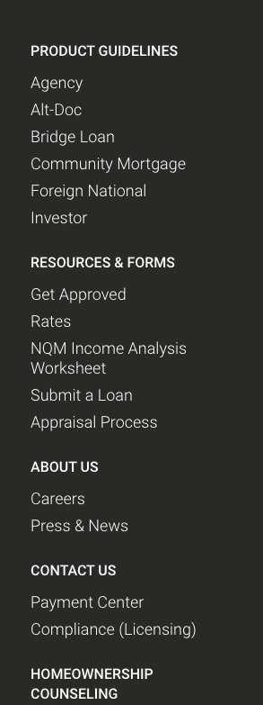
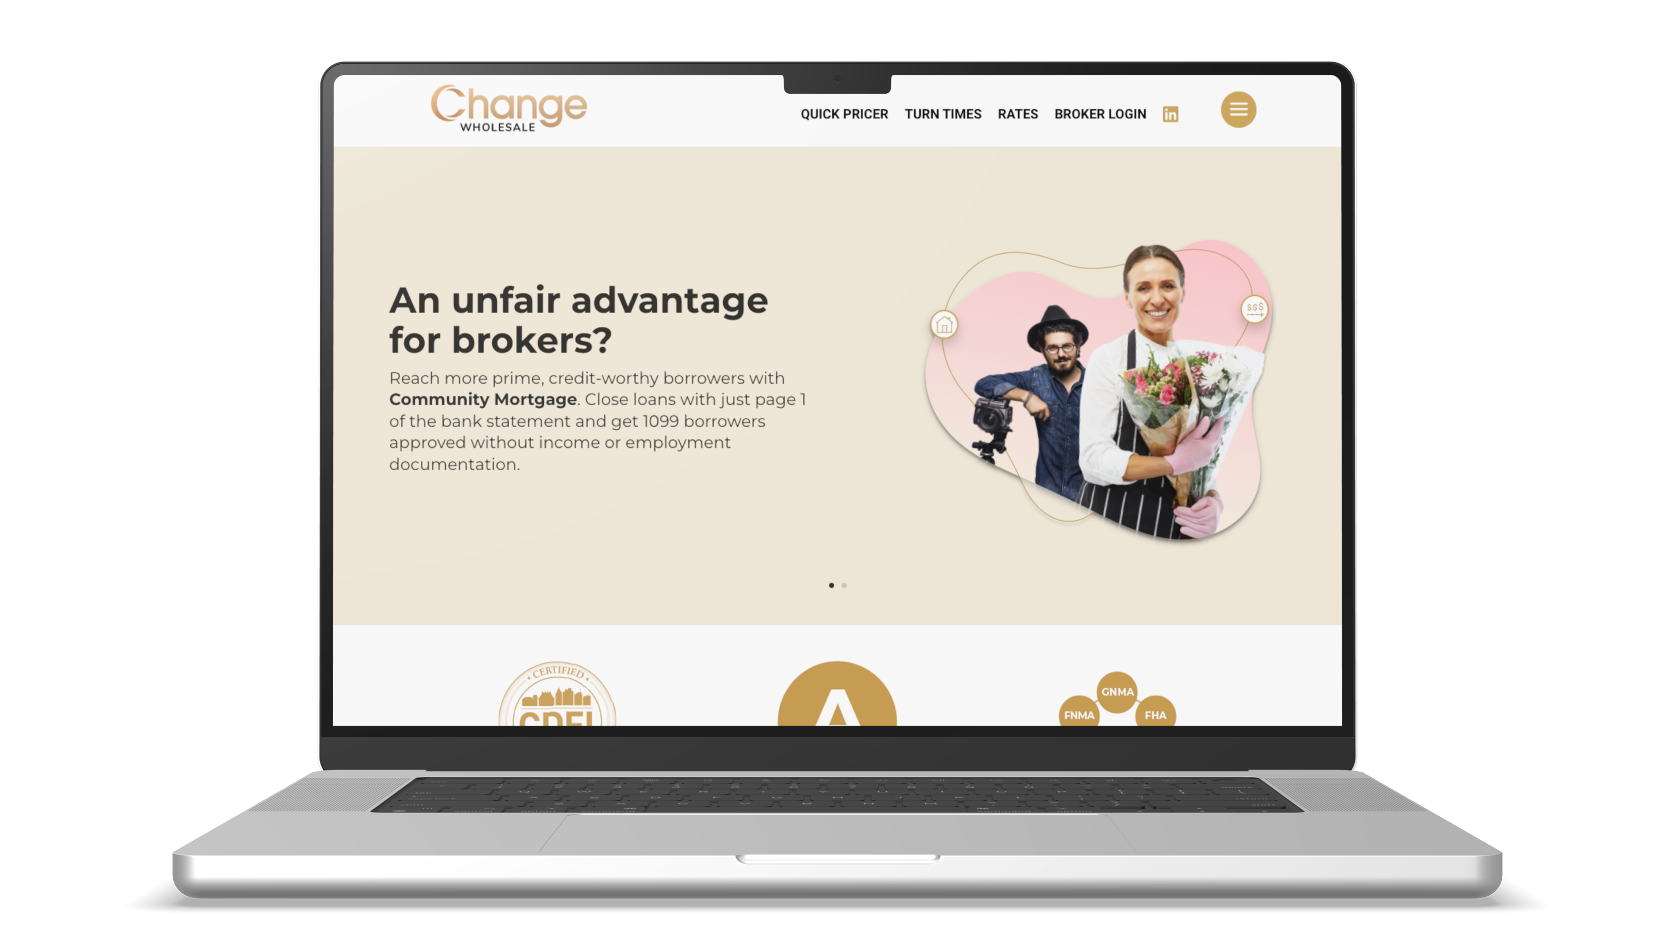
Change Wholesale Website Quick Pricer & Guidelines
Quick Pricer & guidelines available on our website - no credentials needed: ChangeWholesale.com

Slide 15
PROCESS & CLOSR
PROCESS
It all starts with knowing what you have to offer. . .
- CONGRATULATIONS! You have almost completed the first step in the process!

Slide 16
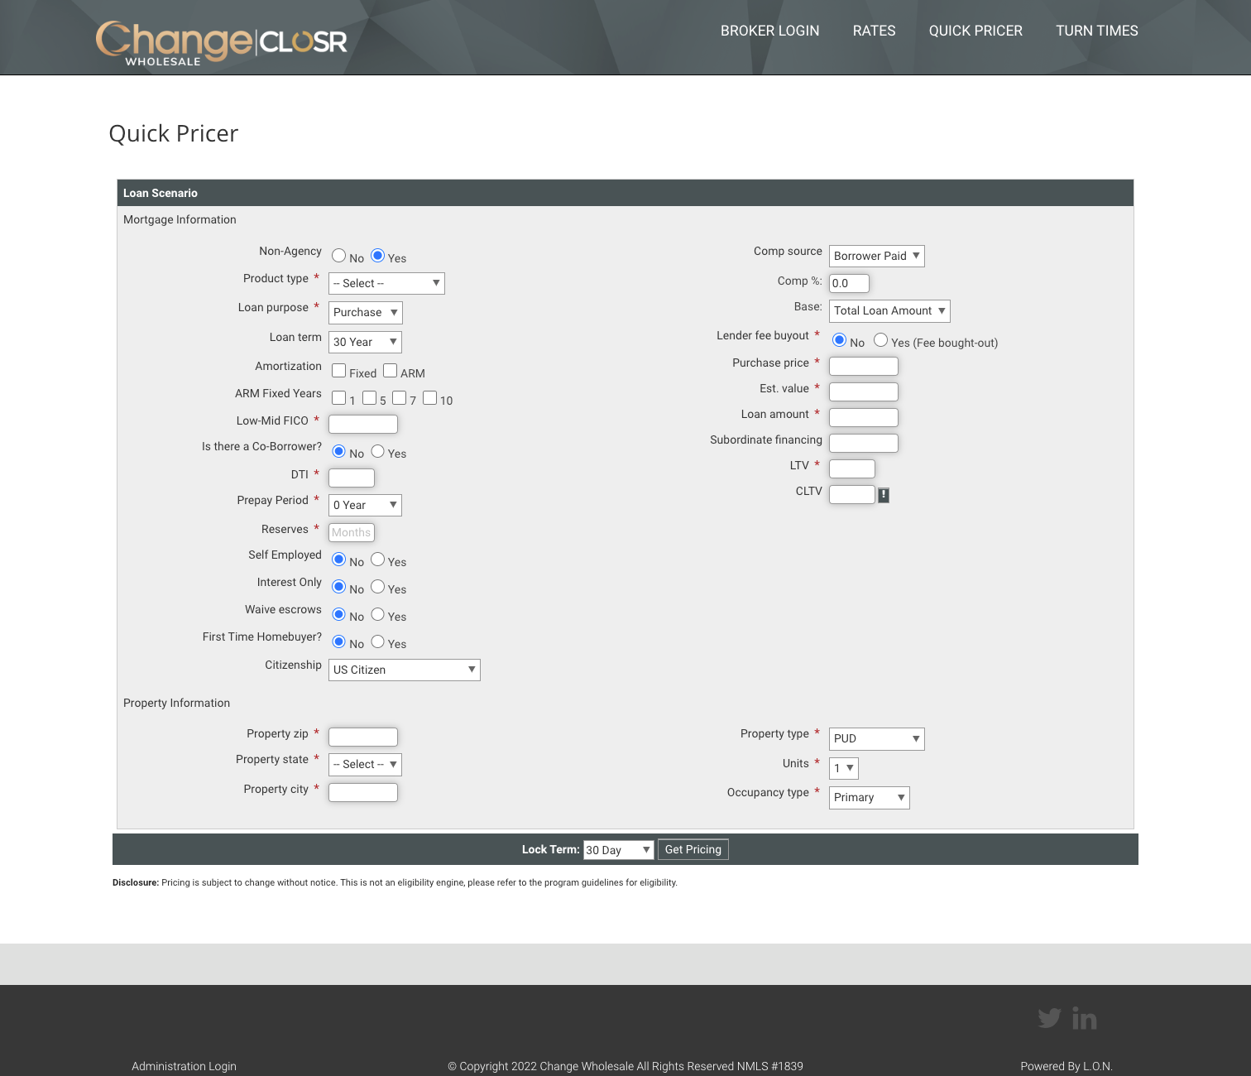
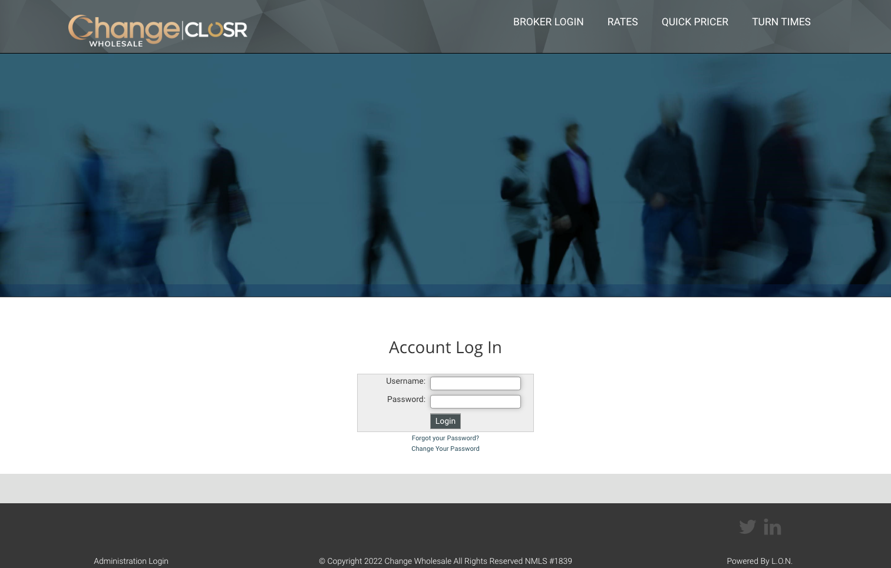
How to Access Quick Pricer
Quick Pricer available on ChangeWholesale.com and CLOSR Portal.

Slide 17
PROCESS & CLOSR
is our proprietary loan portal
www.changewholesale.com
It is an intuitive/user friendly portal- reach out to me for logins
Training is available weekly:
- Tuesdays @ 2:00PM EST Click Here for Zoom Meeting
- Thursdays @ 2:00 PM EST Click Here for Zoom Meeting
Best practice: while loan is in the queue for initial UW, work with the team and continue to upload necessary conditions.
Post approval: review all PTD’s and if there are ANY questions, address and resolve with myself or Charlene.
CHARLENE Inside Account Manager
C: 949.255.6087
E: Charlene.Fivecoat@changewholesale.com

Slide 18
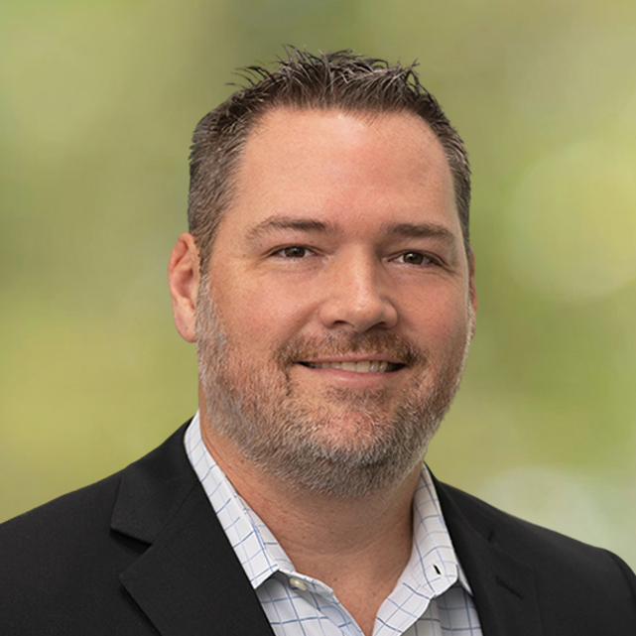
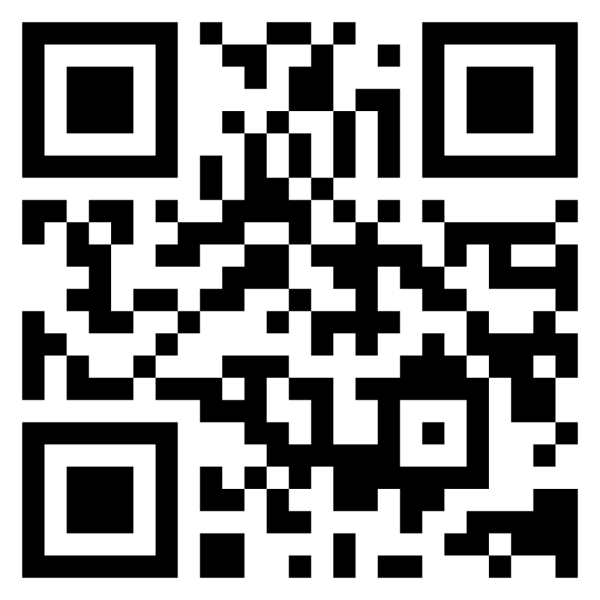
Clark Knoblock
Email: Clark.Knoblock@ChangeWholesale.com
Direct: (818) 612-7246
THANK YOU
Learn more about our unfair advantage at
ChangeWholesale.com/Clark
Change Lending, LLC dba Change Wholesale is a state-licensed mortgage lender, NMLS ID #1839. To verify licenses, visit www.nmlsconsumeraccess.org. Headquartered at 175 N Riverview Drive, Anaheim, CA 92808. AZ: Arizona Mortgage Banker License #0925326; CA: Licensed by the Department of Financial Protection and Innovation under the California Residential Mortgage Lending Act and California Financing Law; CO: Regulated by the Division of Real Estate; GA: Georgia Residential Mortgage Licensee #48010; MN: This is not an offer to enter into an agreement and an offer may only be made pursuant to Minn. Stat. §47.206 (3) & (4); NJ: Residential Mortgage Lender License – Licensed by the N.J. Department of Banking and Insurance; OH: Licensed by the Ohio Department of Commerce, Division of Financial Institutions, Ohio Residential Mortgage Lending Certificate of Registration #RM.804654.000. RI: Rhode Island Licensed Lender #20224336LL. For other states, visit www.changewholesale.com. All loans must meet underwriting guidelines. This information is intended for the exclusive use of licensed real estate and mortgage lending professionals in accordance with local laws and regulations. Distribution to the public is prohibited. Subject to change without notice. CHANGE LENDING, LLC AND ITS LOAN PRODUCTS ARE NOT SPONSORED OR ENDORSED OR BEING OFFERED BY THE U.S. TREASURY DEPARTMENT OR ANY OTHER GOVERNMENT AGENCY. Equal Housing Lender. © 2023. Change Lending, LLC. All rights reserved.
030223

